Slide 1

Optimal Control of Probabilistic Dynamics Models via Mean Hamiltonian Minimization
Workshop on Stochastic Planning & Control of Dynamical Systems
CDC, 2025.
David Leeftink
Radboud University, the Netherlands.

Slide 2
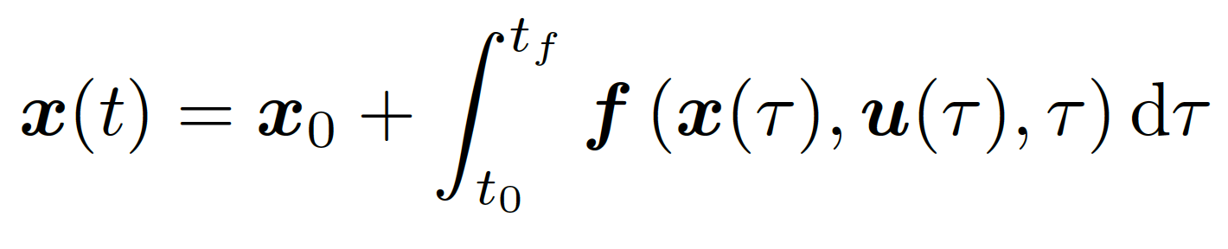
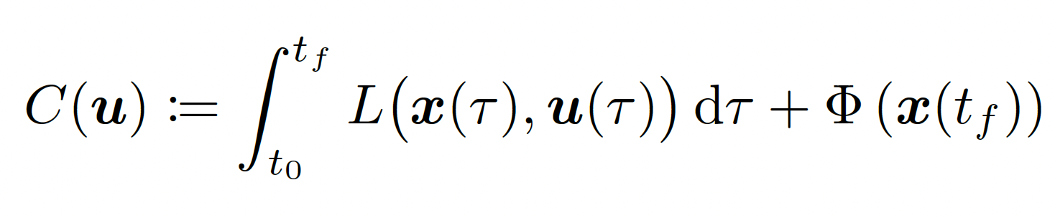
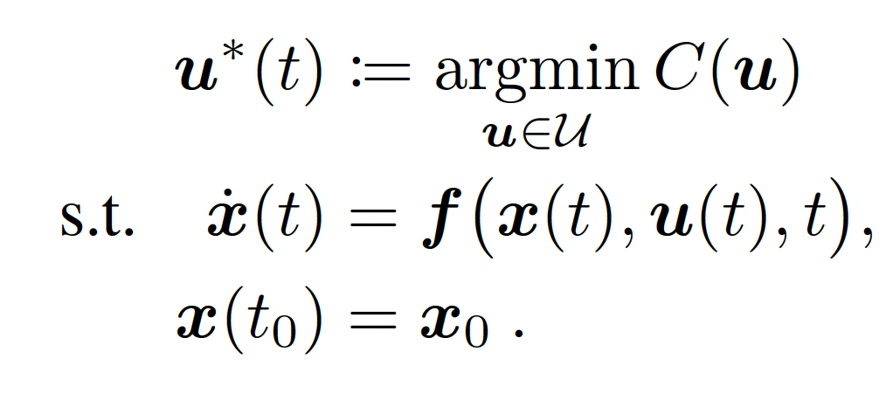
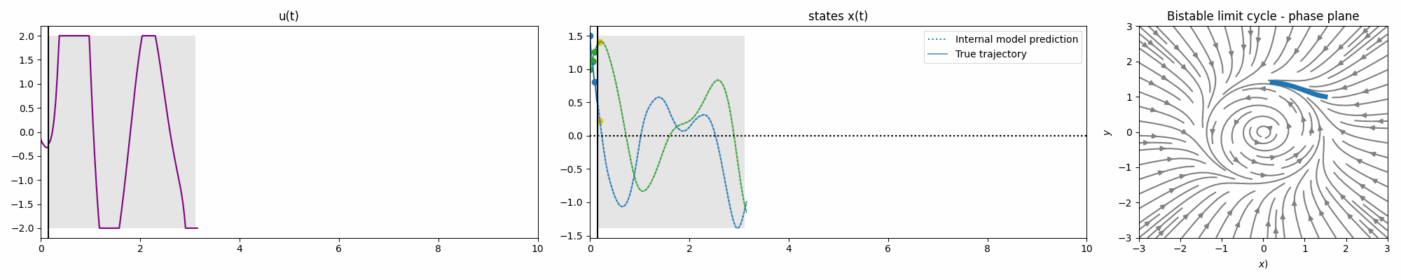
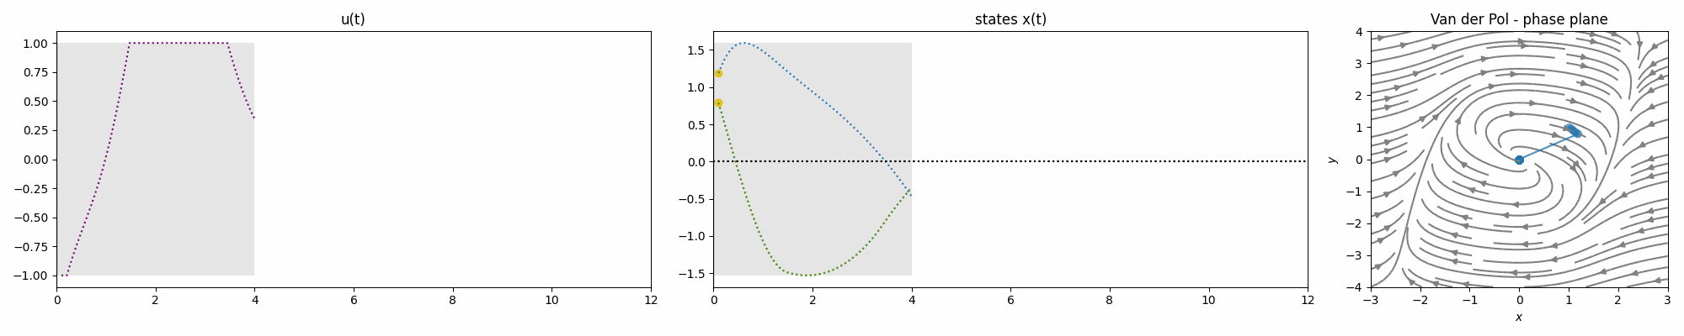
Optimal control and online planning
Non-linear control system
Objective
Task

Slide 3
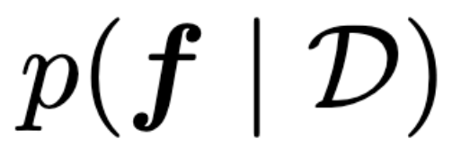
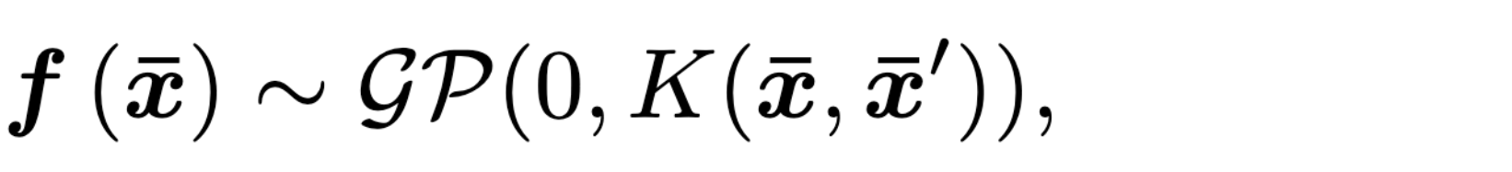
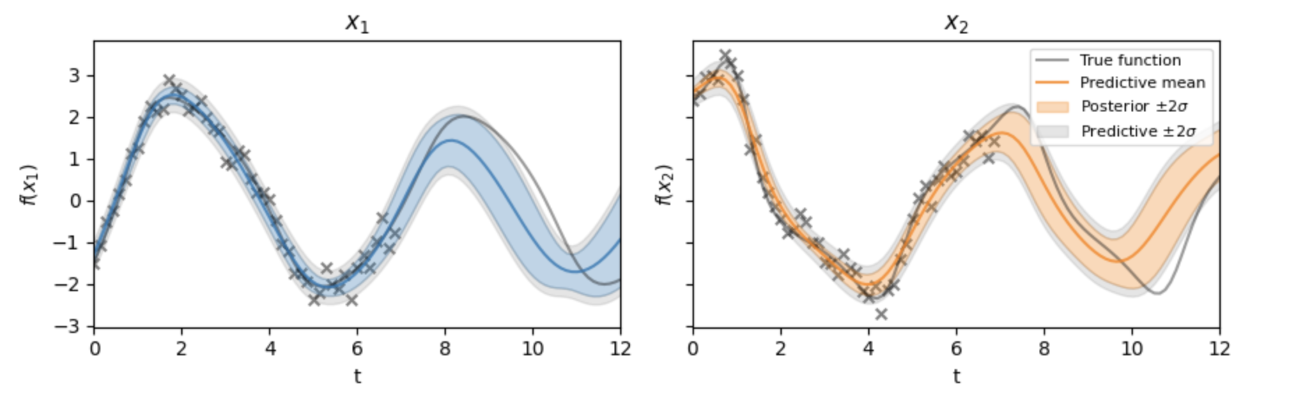
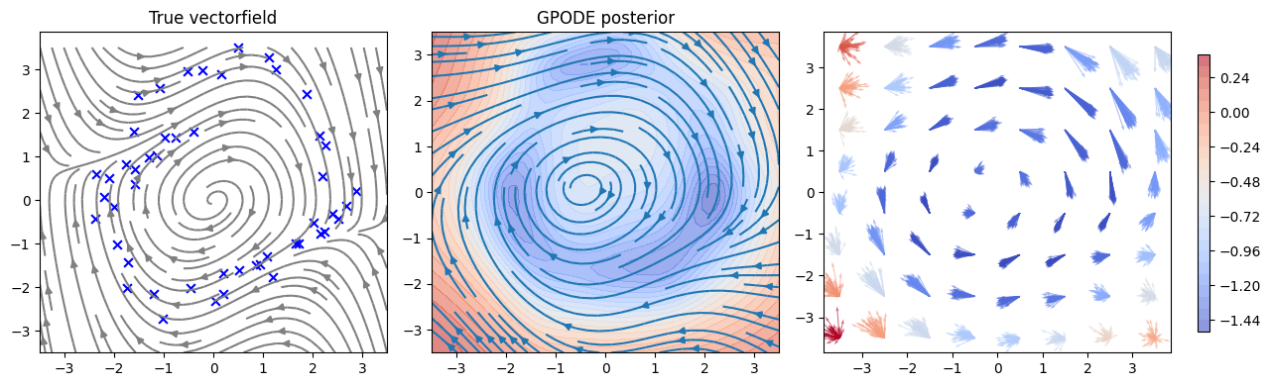
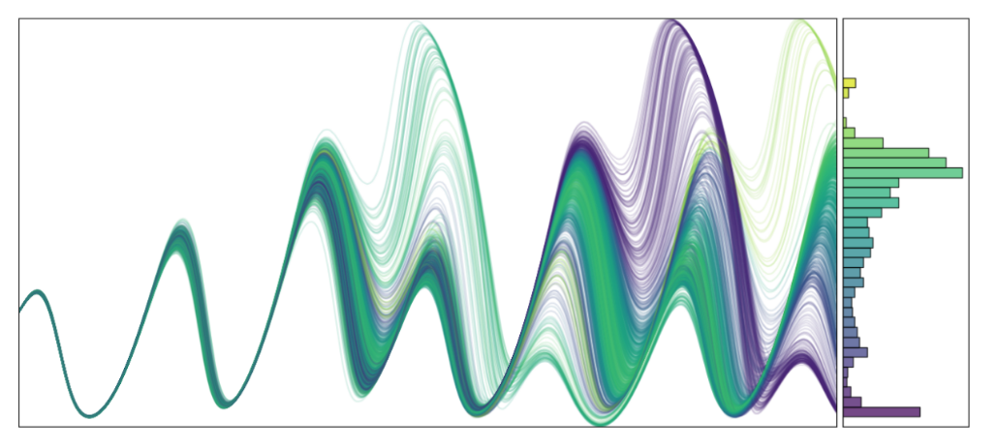
Prior
Uncertainty in RL
A model-based perspective
Likelihood
Prediction
Uncertainty as crucial component in MBRL
  deterministic: Small errors can be exploited
  Infer posterior distribution over dynamics
  + Data-efficiency
  + Safety
Planning:
  MPC: Optimize actions over receding horizon
  Learned posterior over f
Challenge:
  Trajectory optimization becomes significantly harder
Posterior

Slide 4
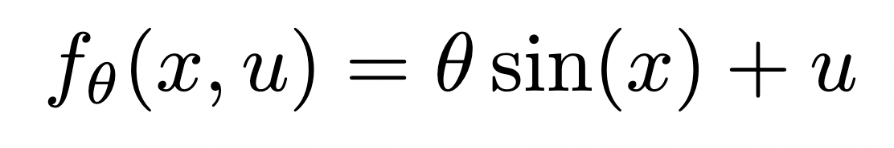
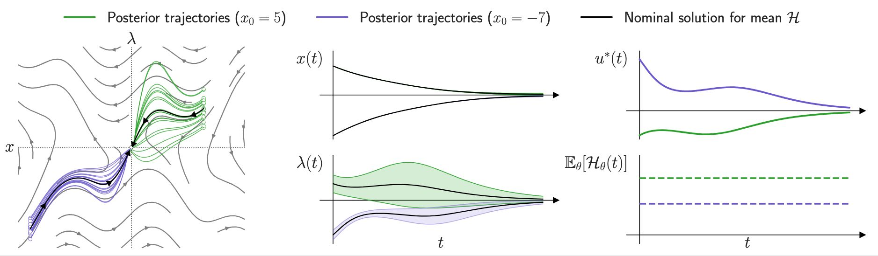
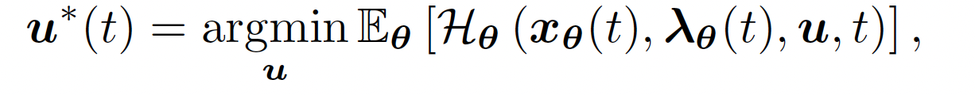
Mean Hamiltonian Minimization
Necessary condition of optimality with model uncertainty
Mean Hamiltonian Minimization

Slide 5
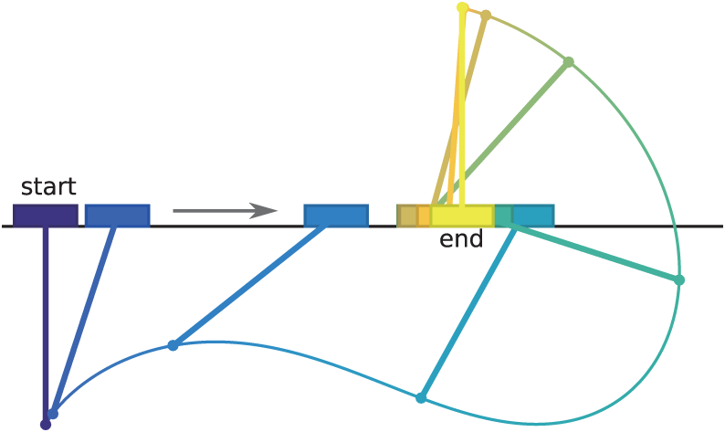
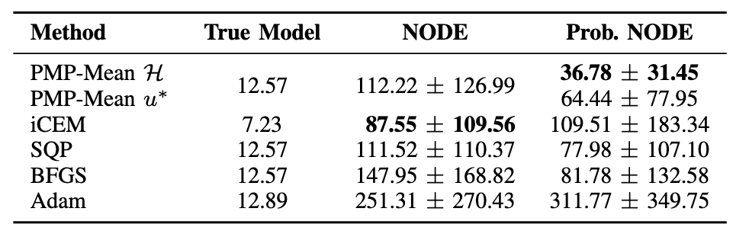
Empirical results: offline RL
Numerical algorithm:
Two Point Boundary Value Problem (TPBVP)
  The initial states are known, but not the initial co-states
Forward multiple shooting to identify co-states
  Levenberg-Marquart
Cartpole swingup
Goal: balance at the center of the stable limit cycle dynamics, given limited data.
MPC with deep neural ensemble model
Compare various trajectory optimizers
Results: Mean Hamiltonian (PMP-Mean H) achieves lower mean cost and reduced variance
Cartpole image by Kelly, M. (2017)

Slide 6

Take-home message
Model uncertainty is essential in RL, but introduces challenging optimization problem
Can be alleviated with classical control theory tools (PMP)
Mean Hamiltonian Minimization:
  Necessary Conditions of Optimality for model uncertainty
  Alternative for Planning in MPC in RL
  Naturally handles Continuous-time formulation.
Contact: david.leeftink@ru.nl
Website: https://davidleeftink.github.io
QR code: paper and open-source code

